Slide 1
Driving effective compliance
risk management
Christine Tacon
24 June 2019
@UKGCA
#GCA2019

Slide 2
Performance analysis -
Statutory reporting requirements

Slide 3
Statutory reporting requirements
Disputes referred to arbitration under the Groceries Supply Order | The GCA accepted appointment as arbitrator in no disputes in the reporting period.
Investigations carried out by the GCA | The GCA concluded the investigation into Co-operative Group Limited on 25 March 2019. This was the GCA’s second investigation.
Cases in which the GCA has used enforcement measures | The GCA made recommendations to Co-operative Group Limited.
Recommendations that the GCA has made to the Competition and Markets Authority for changes to the Code | The GCA has made no recommendations to the Competition and Markets Authority for any change to the Code.

Slide 4
Performance analysis -
Strategic objectives

Slide 5
Promoting the work of the GCA
19
44
DIFFERENT
EVENT & MEETING LOCATIONS ACROSS THE UNITED KINGDOM
1,792
SUPPLIER AND TRADE ASSOCIATION EVENTS
CODE CONFIDENT PACKS HANDED OUT

Slide 6
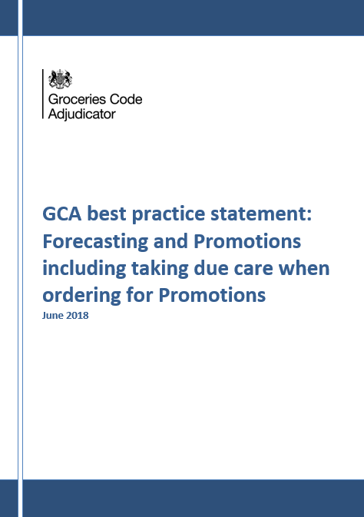
Providing advice and guidance
1
Best
Practice
NEW BEST PRACTICE STATEMENT

Slide 7
Acting on supplier issues
96
SUPPLIER
ONE-TO-ONES

Slide 8
Improving the culture of Code compliance
Continued to meet CCOs
Visited five retailers
Met chairs of retailer audit committees
Engaged with retailer CEOs
52
RETAILER MEETINGS

Slide 9
Report of investigation into
Co-operative Group Limited

Slide 10
Report of investigation into Co-operative Group Limited
Co-op breached the Code:
It failed to provide reasonable notice to suppliers of decisions to de-list products
It varied supply agreements unilaterally and without reasonable notice in the way it applied two specific charges
10

Slide 11
Root causes of both breaches
Compliance risk management, proactively undertaken at all levels in the business
Legal, compliance and audit functions working to support Code compliance
Internal systems and processes working to support Code compliance
Training on the Code
Communication between the retailer and suppliers facilitating Code compliance
11
11

Slide 12
Recommendations made to Co-op
Co-op must have adequate governance to oversee and manage its compliance with the Code.
Co-op legal, compliance and audit functions must have sufficient co-ordinated oversight of Co-op systems to ensure Code compliance.
Co-op IT systems must support Code compliance.
Co-op must adequately train on the Code all employees who make decisions which affect a supplier’s commercial arrangements with it.
Co-op must in any potential de-listing situation communicate with affected suppliers to enable the retailer to decide what is a significant reduction in volume and reasonable notice.
12

Slide 13
Top Issues

Slide 14
Driving effective compliance
risk management

